Slide 1

DEVX- NAVIFY Meetings Visual Journey

Slide 2
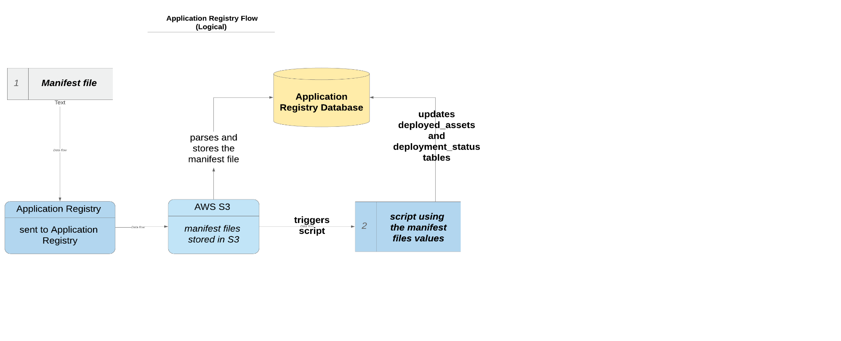
NAVIFY Platform Support Model
The Application Registry Service

Slide 3
NAVIFY Document Life Cycle
Request for Content
Content Request
> Request for new content or content update
>Requestors can be:
>Product Owner
>DevOps Team
> Stakeholders
>Request is assigned to Author
Content Validated
> Product Owner and other stakeholders validate initial draft
>Editorial and technical reviews dates are agreed.
Content Developed
> Based on feedback during validation of initial draft is developed.
Content Approved
Content is Published
Content Designed
Request is Analysed
>Request is analysed:
> New content?
OR
> Update?
> Information resources identified and contacted.
>Priorities and workplan are agreed
>Resources are engaged in the document design
> Information researched
> Document is drafted
1) Document goes for editorial review
2) Document goes for technical review
3) Document goes for approval.
If the document is approved review comments are implemented
OR
If the document is rejected back to phase 5 (changes made, comments implemented)
> Approved document is published

Slide 4
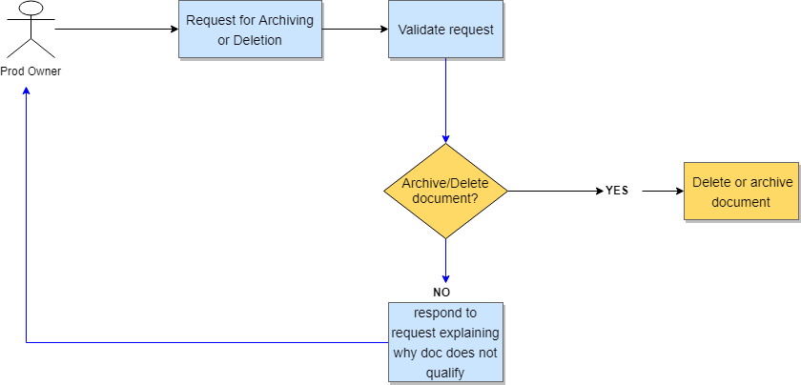
Document Archive Request

Slide 5
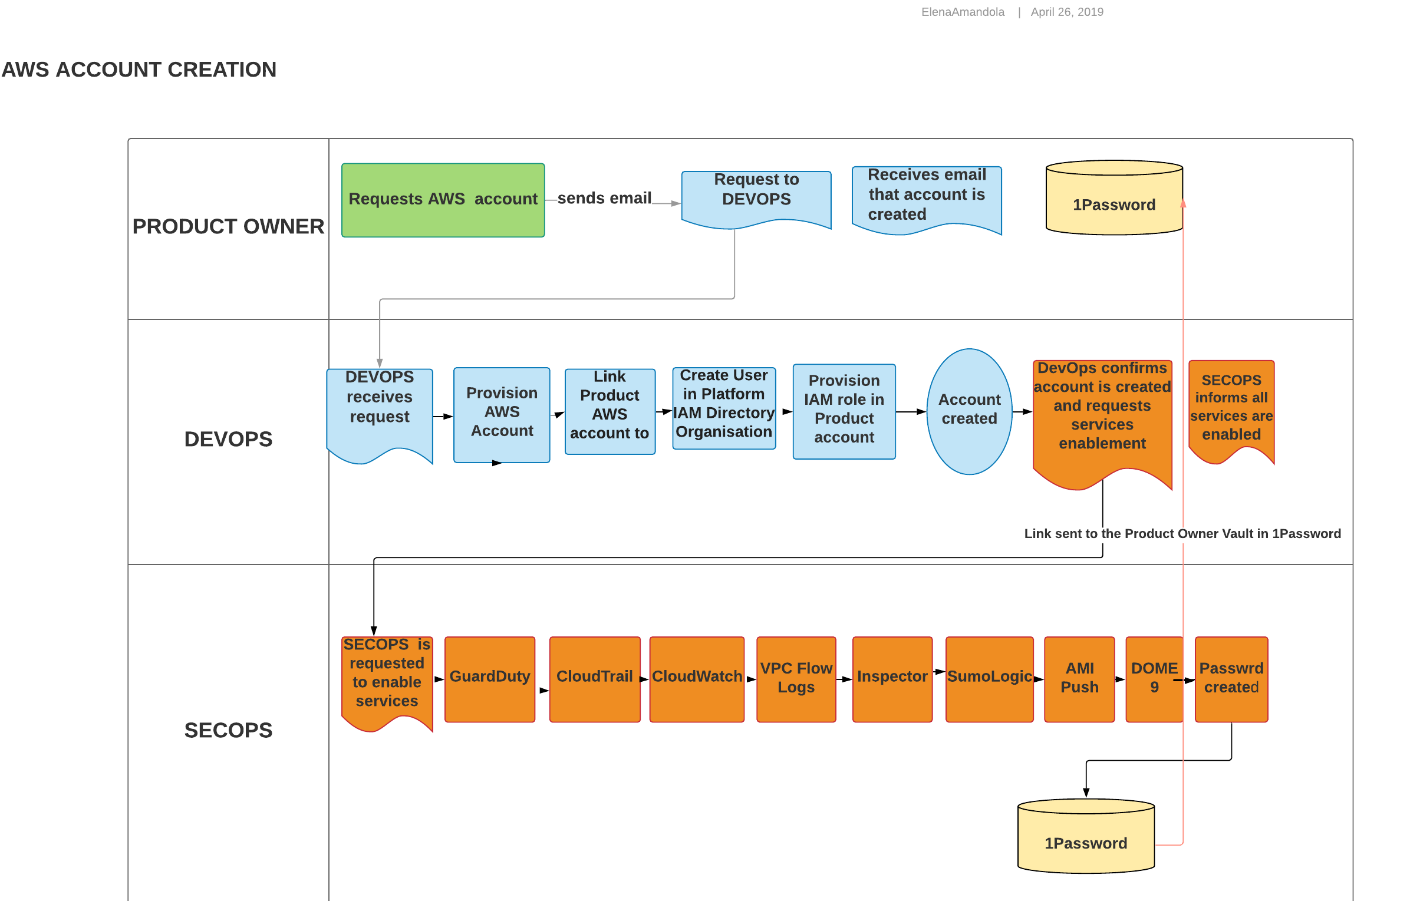
AWS ACCOUNT CREATION

Slide 6
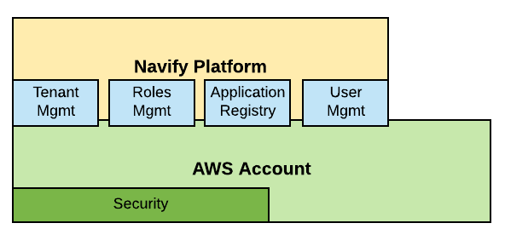
Navify Platform Services Structure

Slide 7
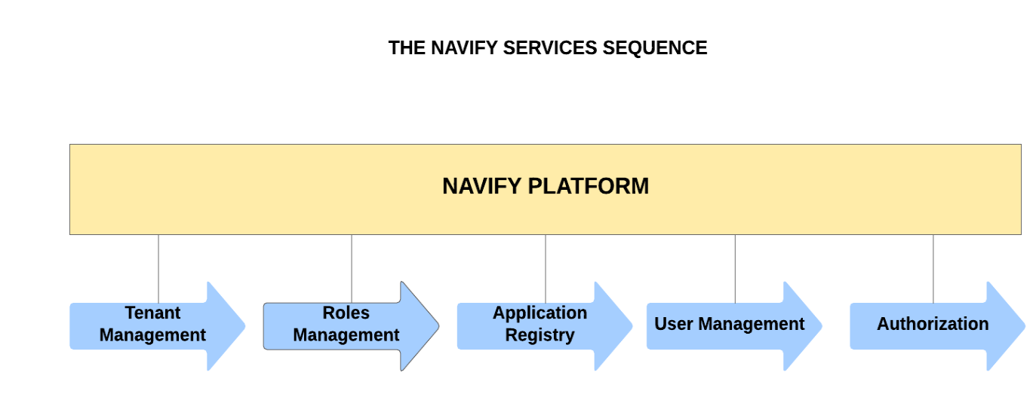
Navify Platform Services Sequence

Slide 8
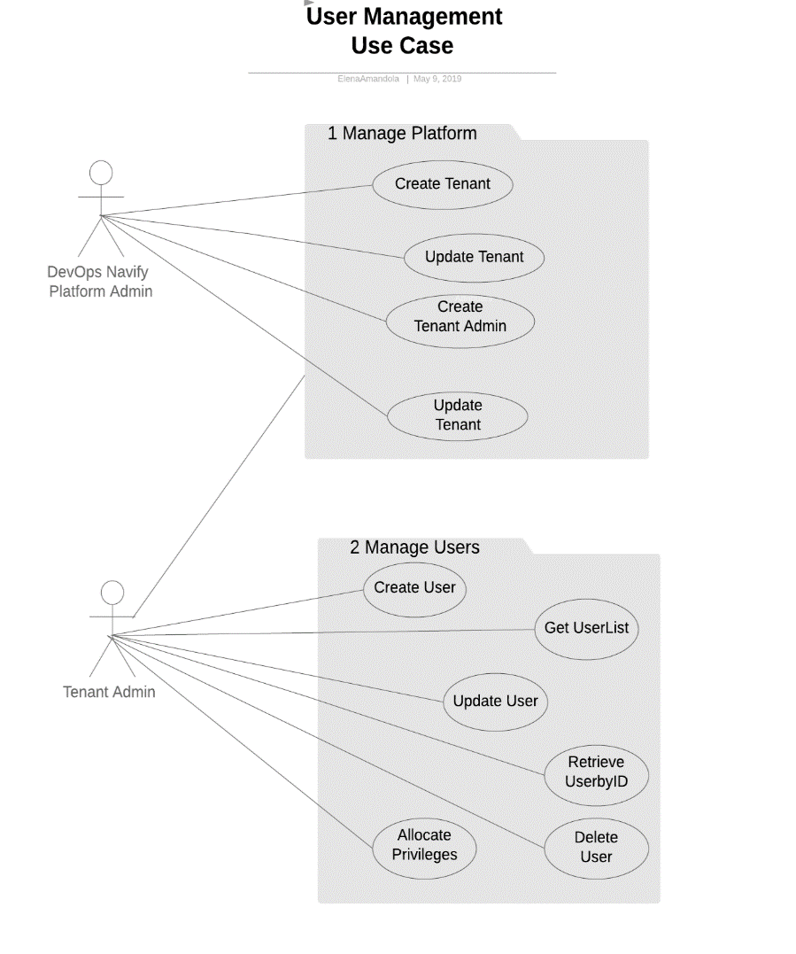
User Management Use Case

Slide 9
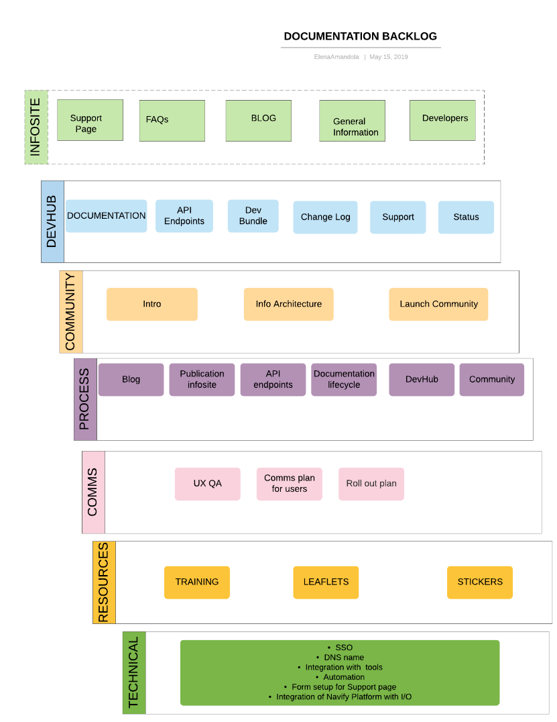
Navify Platform Documentation Plan

Slide 10
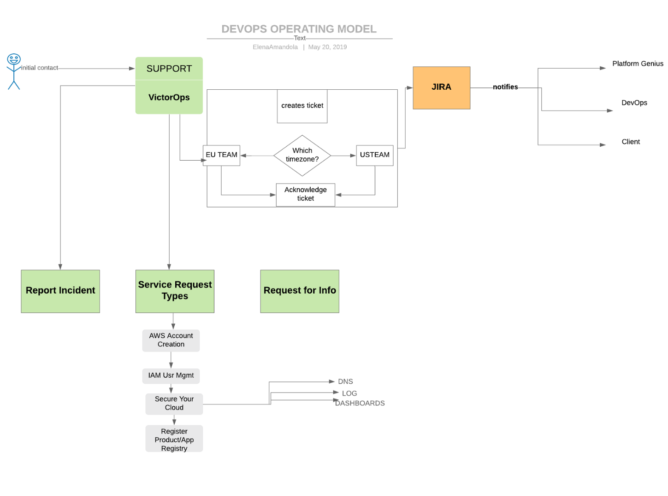
DEVOPS HIGH-LEVEL OPERATING MODEL

Slide 11
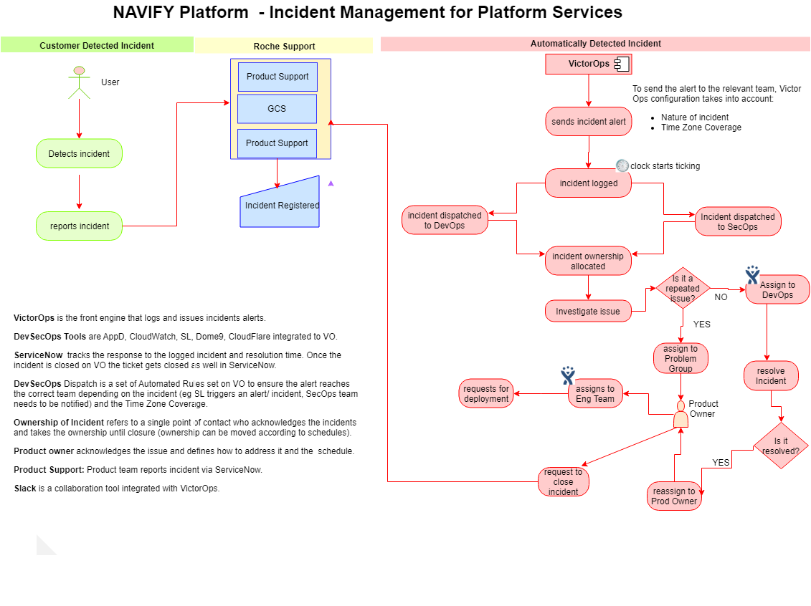
Navify Platform – Incident Management for Platform Services

