Slide 1
NAVIFY Platform Info Site
Blog Publication Process

Slide 2

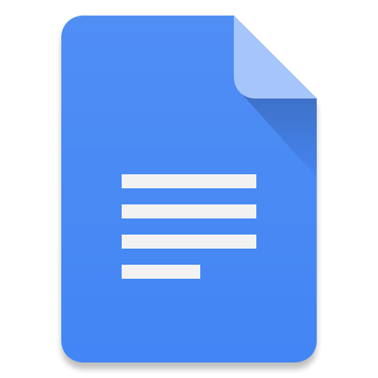
NAVIFY Platform Blog publication process
01. Acknowledge receipt:
01.1: The blog entry will be recorded in JIRA as a story in the NP Redbacks backlog (LINK to backlog: https://navifypoc.atlassian.net/issues/?filter=10094)
01.2: The author will be notified that their blog post is added to the queue to be processed
02. Language review
02.1: Blog post will be reviewed by technical writer
02.2: A new post entry will be prepared in gDoc for review in draft status
02.3: Tags and categories assigned to blog post entry (example: Compliance, Certifications (HiTRUST, ISO,...), Law references (GDPR, HIPAA,...), Encryption, Key management, …)
03. Ready for SME review
03.1: Drafted blog post will be moved to 'Pending Review'
03.2: Review team will be notified via email of a new blog post pending review
03.3: SMEs will review and inform author & DevX team of any necessary updates.
NOTE: If no response within 5 days, blog post is published automatically
04. Publish and communicate
04.1: DevX team publishes blog
04.2: Blog author and portal subscribers are notified of the new published blog post
Acknowledge receipt
Blog in
gDoc
Anyone that would like to contribute
Language review & Draft in Wordpress
End user activities
DevX team activities
Ready for SME Review (5 days layover)
Update & Publish on Wordpress
Communicate

