Slide 1
ACTIVITIES & DEPENDENCIES
Around CLI Documentation

Slide 2
ACTIVITIES
Migration
Conversion
CLI Restructuring
Re-branding
Technical Writing standards

Slide 3
DEPENDENCIES
CLI Restructuring
  Conversion
  Migration to One Appfire instance
  Technical Writing standards (Style Guide and so on are part of the post-migration)
  Is the re-branding done at page or instance level?

Slide 4
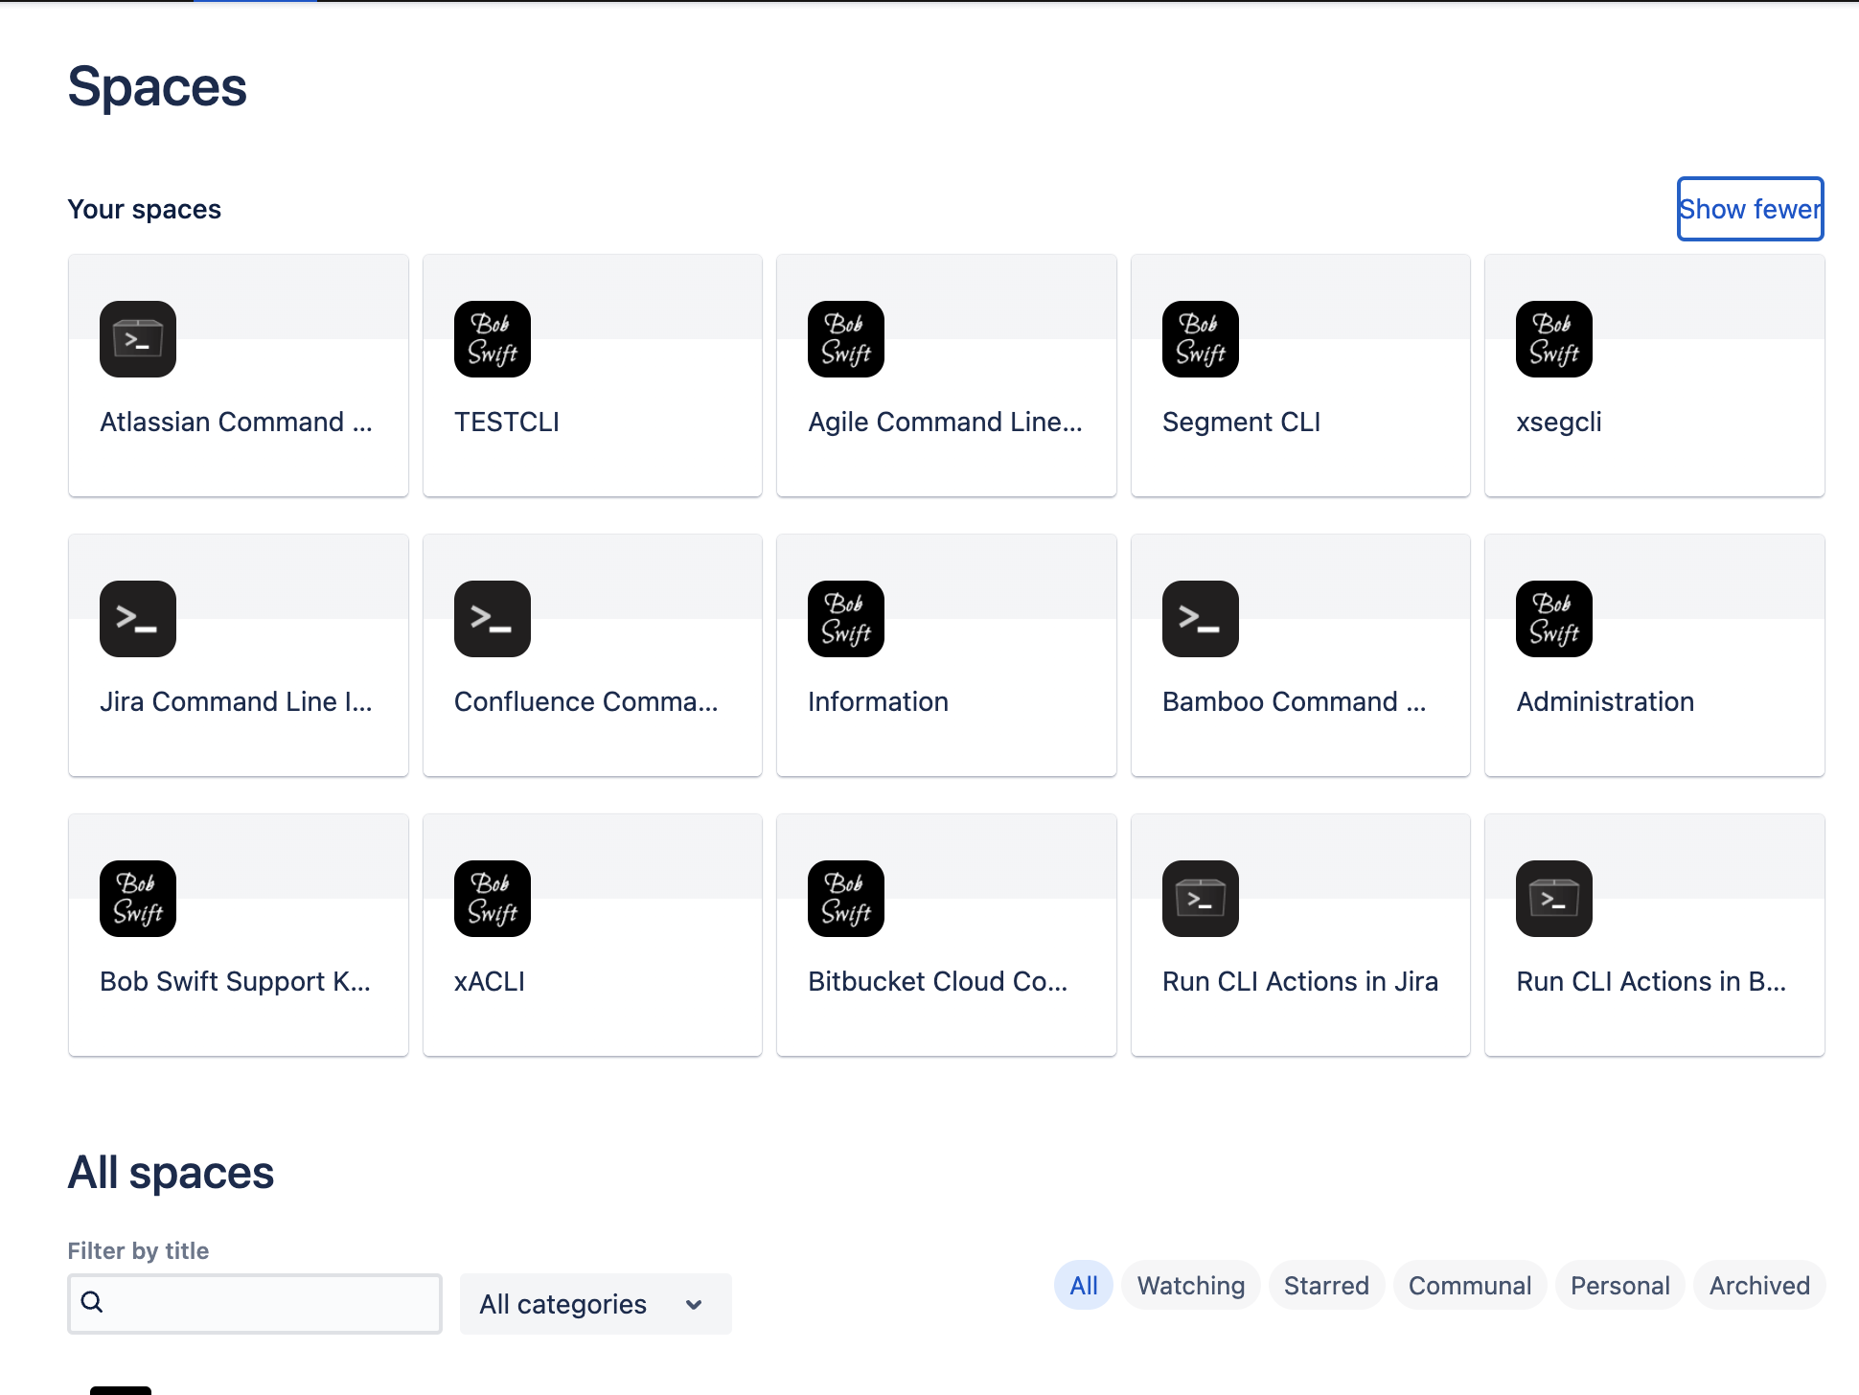
Current Spaces

Slide 5
The slide shows the current spaces prior to migration. Some are internal and some public.
The instance is organised that to each product corresponds a space in Confluence.
ADVANTAGES
Clear separation between each product.
DISADVANTAGES
Duplication of content
Maintaining each space is more time consuming

Slide 6
PROPOSED STRUCTURE
The new structure would consist of seven spaces:
ACLI Command Line
Connector App Confluence
Connector App Jira
Connector App Bitbucket
Connector App Bamboo
Run Actions Jira
Run Actions Confluence

Slide 7
Command Line Space Connector App Spaces Run Actions Spaces
ACLI Command Line
This space to include:
Getting Started
ACLI Shell overview
ACLI Shell Actions
Connector Apps info
Run Actions info
Confluence Connector App
Run Actions Jira
Jira Connector App
Run Actions Confluence
Bitbucket Connector App
Bamboo Connector App

Slide 8
CONSIDERATIONS AND ACTIONS
Given the dependencies around migration and unknowns eg technical writing standards, landing pages, re-branding, how do we wish to proceed?
Perhaps consider to put the restructruring on hold and focus on other activities.

