Slide 2
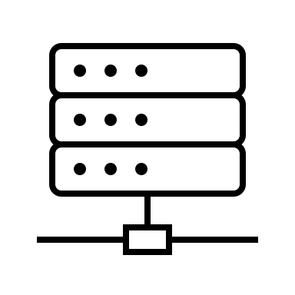



Atlassian apps
Administrator installs Atlassian apps on server
or Cloud
Connector
Apps
ACLI CLIENT
User installs on local machine ACLI
ACLI CLIENT
ACLI CLIENT

Slide 3

ACLI CLIENT
ACLI CLIENT
ACLI CLIENT
ACLI CLIENT
ACLI CLIENT
ACLI SHELL
SERVER
CONNECTOR APPS
ATLASSIAN CLI APPS
JIRA CLI
CONFLUENCE CLI
BITBUCKET CLI
BAMBOO CLI

